Slide 1
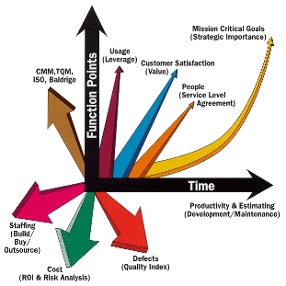
Software Quality Metrics
What do you measure?
Ch 4 in Kan
Steve Chenoweth, RHIT
Notes:
Image from http://softwaretestingbank.blogspot.com/2009/05/function-points.html.

Slide 2

How do we know if it’s “quality”?
Mean time to failure
Defect density
Customer problems
Customer satisfaction
Do you see “quality” here?
Notes:
Image from http://hdwallpapersuk.com/high-quality-hd-wallpapers/.

Slide 3
ANSI 982.2
An error is a human mistake that results in incorrect software.
The resulting fault is an accidental condition that causes a unit of the system to fail to function as required.
A defect is an anomaly in a product.
A failure occurs when a functional unit of a software-related system can no longer perform its required function or cannot perform within its specified limits.

Slide 4
Can we compare?
Defect rate for product 1 vs defect rate for product 2?
Need to “operationalize” the two numbers:
  How many “opportunities for error” (OPEs) during a specified time?
  Often have to compare “failures” instead
  Infer defects
  Time frames need to be similar –
    Lots more defects right after release

Slide 5
Can we even compare LOC?
Are LOC like IQ points – people use them just because they are handy?
Does coding style count, etc.?
“Everyone knows that debugging is twice as hard as writing a program in the first place. So if you are as clever as you can be when you write it, how will you ever debug it?”
―Brian Kernighan
Notes:
Quote taken from http://izquotes.com/quote/299177.

Slide 6
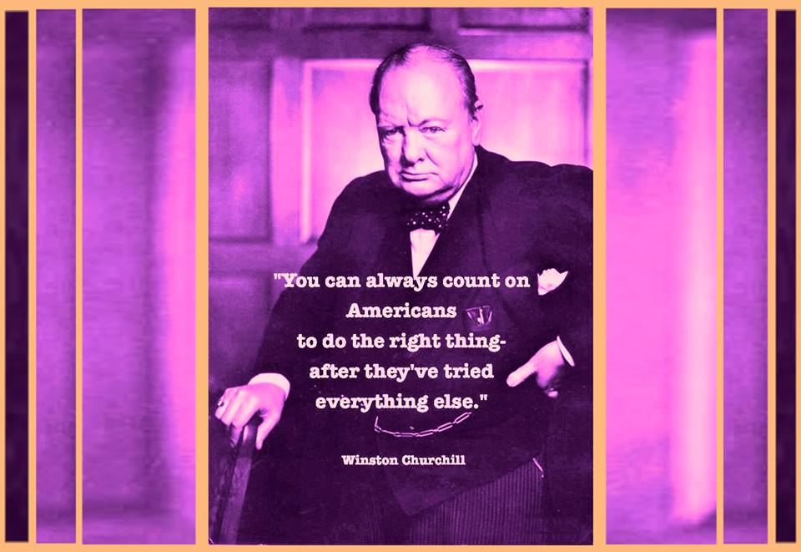
How about this question?
In a next release of a product, what do you count?
  All lines shipped to each customer?
  Just the lines changed?
  Something in-between?
“ A whole nuther way” to consider what counts…
Notes:
Winston Churchill image from http://www.quick-break.net/1876/quotes/you_can_always_count_on_americans_do_the_the_right_thing_-_winston_churchill.

Slide 7
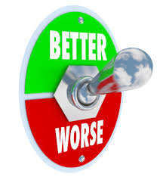
The customer doesn’t care!
They want a decreasing defect rate, over time.
They’ll get spoiled by a good release that had little new stuff in it.

Slide 8
How about function points?
Another way to consider “opportunities for error” (OPEs).
Uses a weighted total of 5 major components:
  Number of external inputs x 4
  Number of external outputs x 5
  Number of internal files x 10
  Number of external interface files x 7
  Number of external inquiries x 4
Notes:
P 93

Slide 9
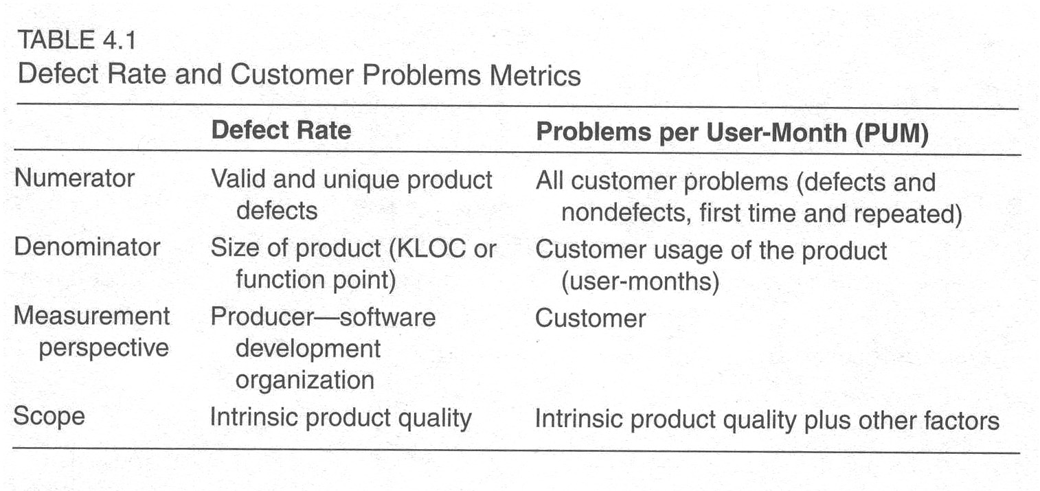
Problems per user-month (PUM)
Problems reported / total license-months
Usually measured after release
Notes:
Kan p 98

Slide 10
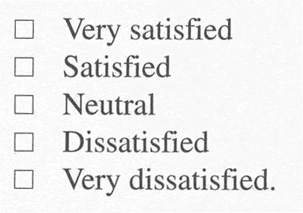
Customer Satisfaction Metrics
Often a 5-point scale:
Can be overall, or
For specific qualities.
HP uses “FURPS”:
  Functionality
  Usability
  Reliability
  Performance
  Service
Notes:
Kan p 98

Slide 11
Customer Sat
Can be expressed to the customer as a question, in different ways:
Completely satisfied?
Satisfied?
Dissatisfied?
Neutral or worse?
Most commonly asked for

Slide 12
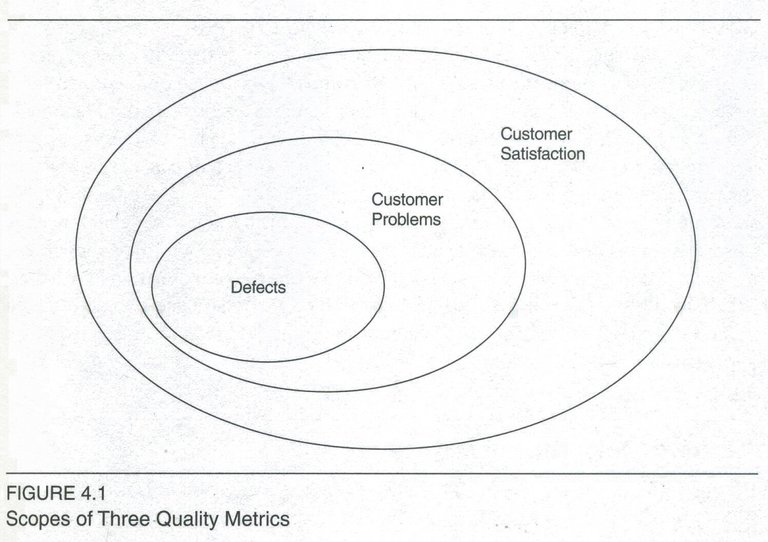
Relative scope of the 3 metrics
These are subset relationships
Notes:
Kan p 99

Slide 13
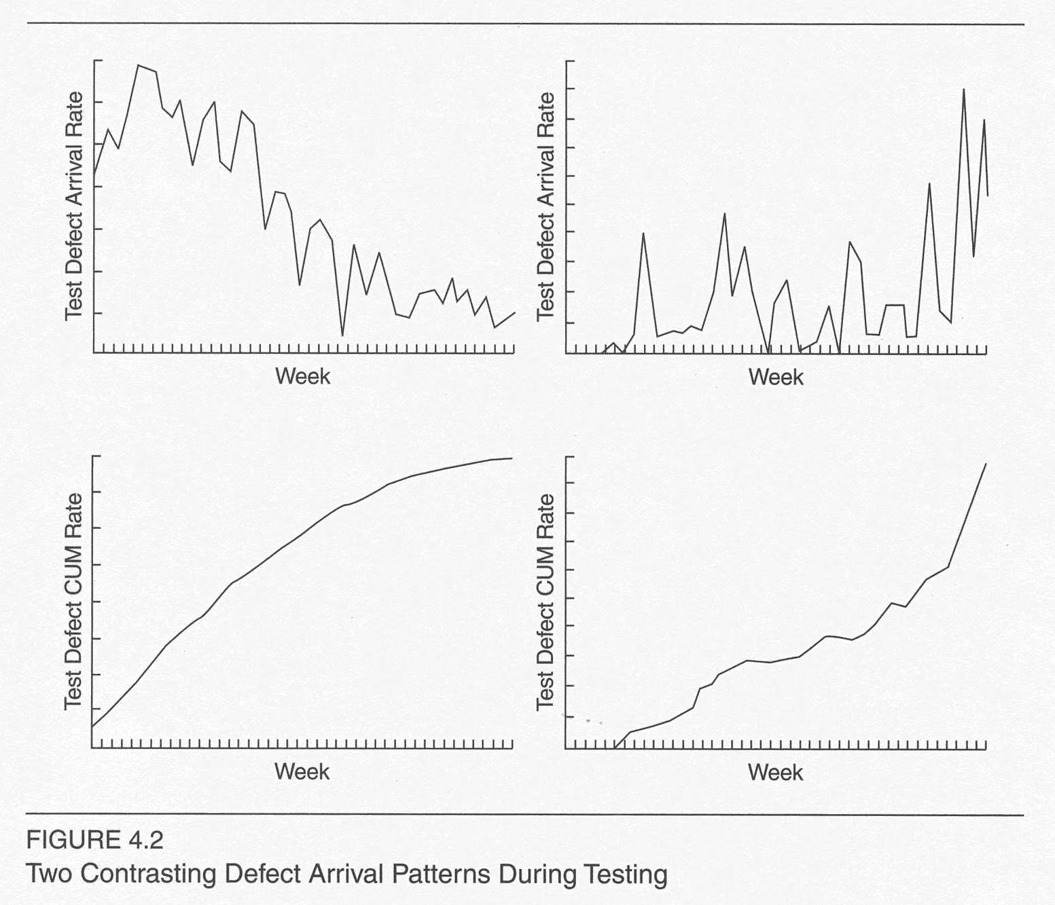
Study of quality processes
The model is from machine testing
We look at defect arrival pattern.
Good – arrivals stabilize at low level!
Notes:
Kan p 102

Slide 14
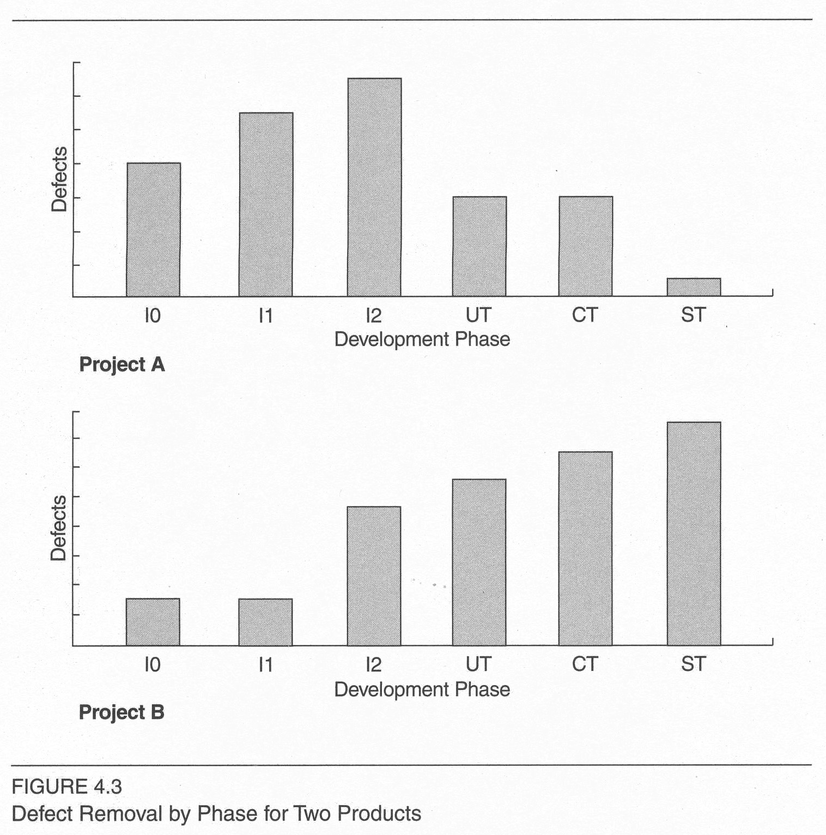
In software, can track in all phases
Moving from phase to phase, this also yields defect removal rates.
Which of these patterns is better?
Notes:
Kan p 104

Slide 15
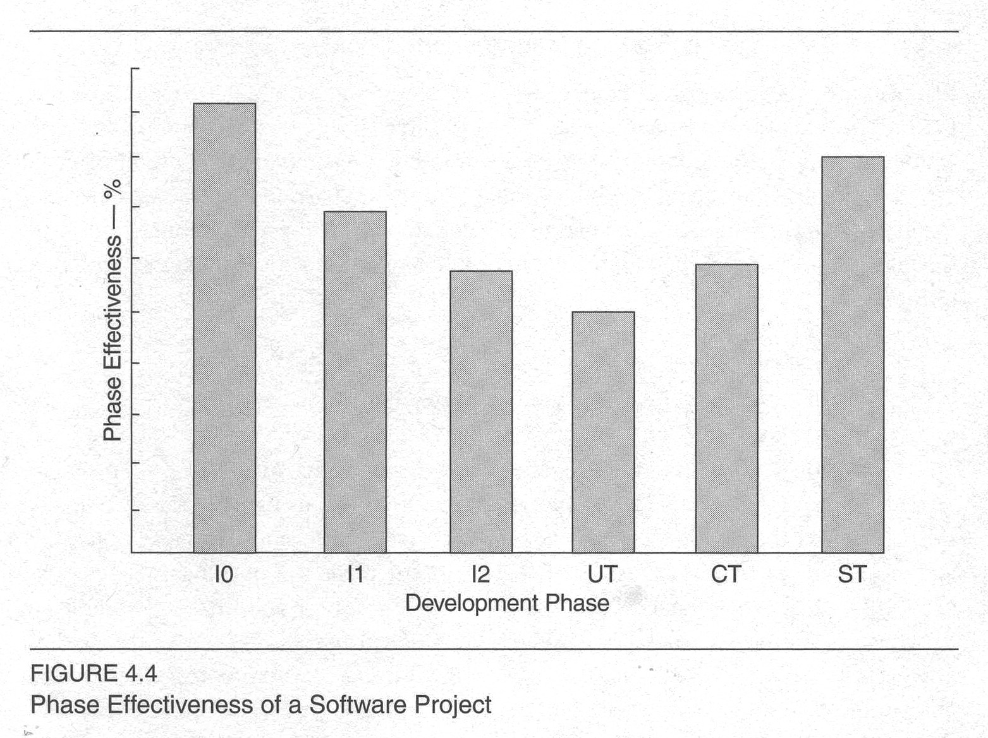
Looking at it in a good way…
“Phase effectiveness”
Tall bars = low number of defects escaped
Notes:
Kan p 105

Slide 16
Maintenance – worth measuring
Typical metrics looked at carefully:
  Fix backlog and backlog management index
  Fix response time and fix responsiveness
  Percent delinquent fixes
  Fix quality

Slide 17

Fix backlog
Open versus closed problems
Backlog management index by month
Notes:
Image – Staring down the backlog – from http://www.solutionsiq.com/resources/agileiq-blog/?Tag=Product%20Backlog.

Slide 18
Fix response time / responsiveness
Mean time of all problems from open to closed
Believed short response times → customer satisfaction
Closely related – percent “delinquent” fixes

Slide 19
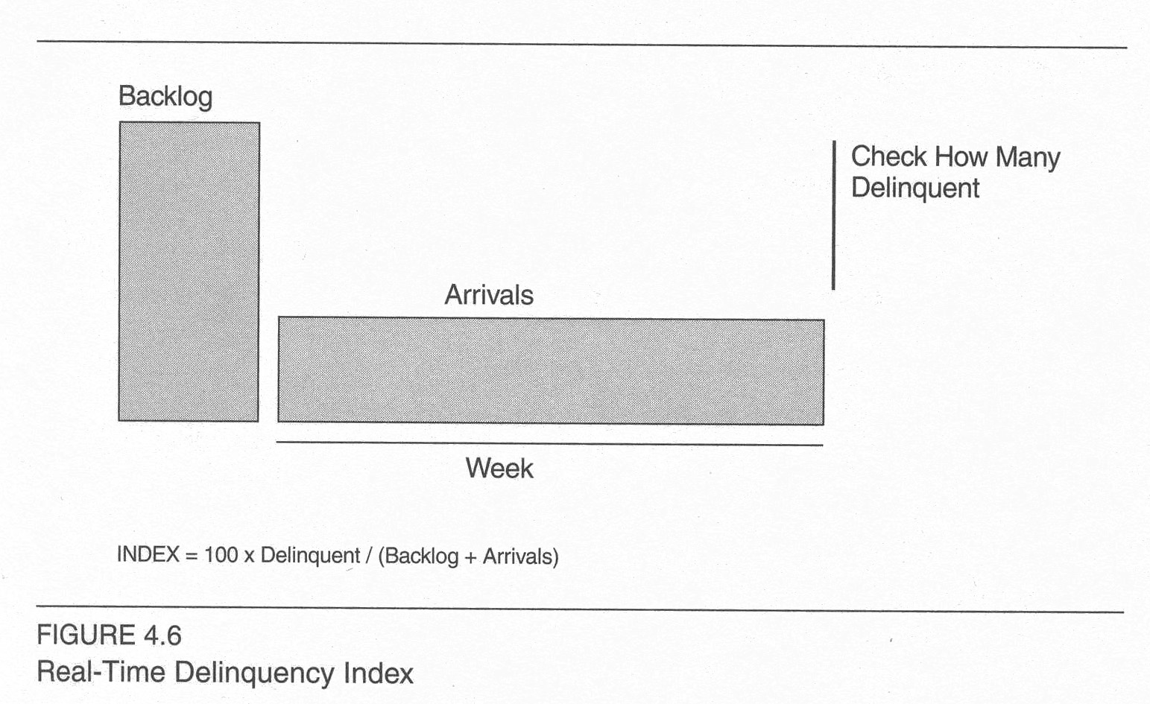
Fix quality
Number of defective fixes:
  Didn’t fix the reported problem, or
  Fixed it but injected a new defect.
Notes:
Kan p 109

Slide 20
Company “metrics programs”
Ok, we all have different ones!
Motorola, for example:
  Includes “SEA” – Schedule Estimation Accuracy
  Etc.
HP:
  Average fixed defects/working day
  Etc.
IBM Rochester:
  Fix response time
  Etc.

Slide 21
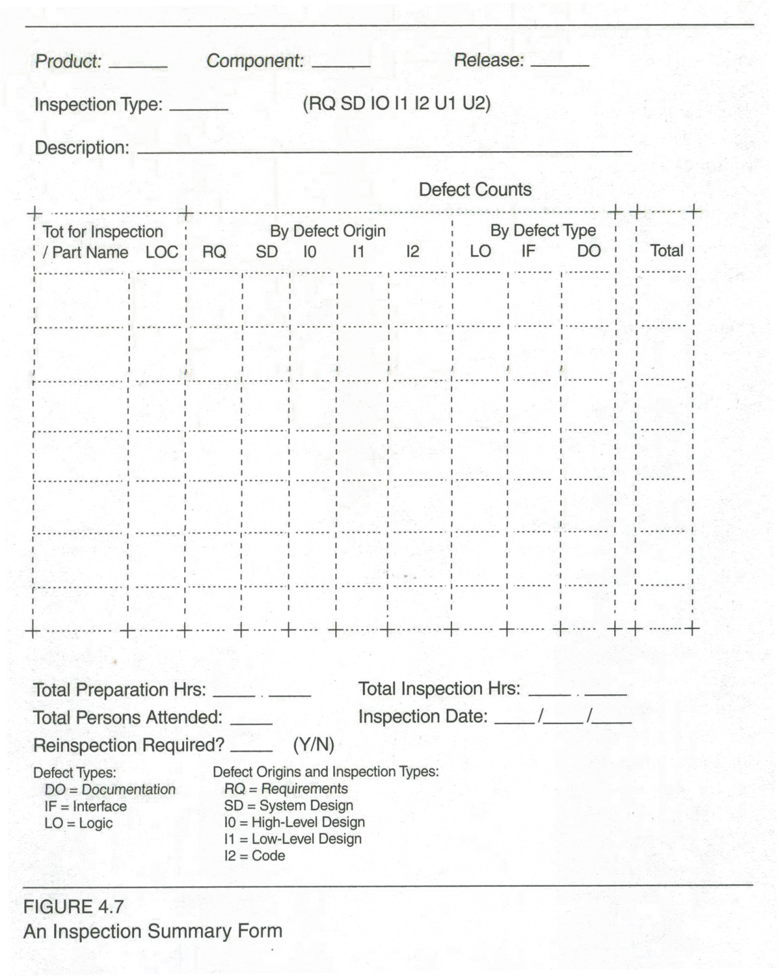
Collecting data
Expensive
Needs consistency
Should be targeted
Often use forms and checklists
See pp 117 - 123
Notes:
Kan p 120

Slide 22
So, what do you use?
How formal are your measurements?
How consistently applied?
How much time does it take?
Who reviews the data?
Who makes process changes?
See Kan’s “Recommendations for small organizations,” pp 124-5.

